Slide 1
Campus Events Calendar
Zhao Wei | Liu Wanpeng| Cheng Siyuan

Slide 2
Project Introduction
Overview of the Project
The Campus Event Calendar project aims to provide a centralized platform for students, faculty, and external participants to manage and view campus events efficiently. This platform will enhance the visibility and participation of events while reducing the scattering of information.

Slide 3
project objective
Develop a centralized platform to manage and notify users about campus events.
Create a user-friendly interface for easy access to event information.
Implement a system that supports RSVP for events, course scheduling, and assignment tracking for students and faculty.

Slide 4
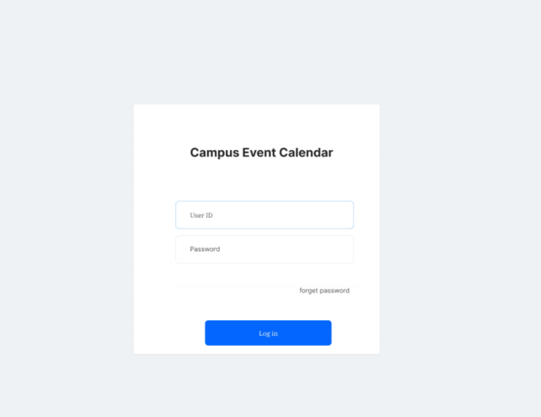
UI Design
Login interface
Design: Contains username and password input boxes, login buttons and forgotten password links.
Function: Provide user access.

Slide 5
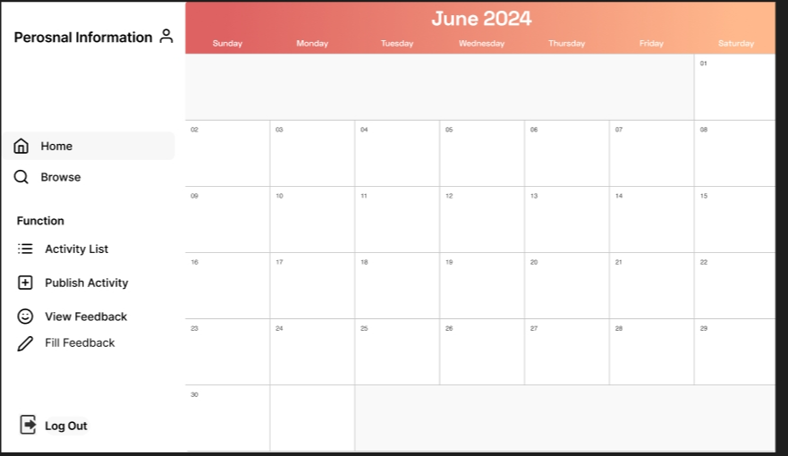
Main interface
Function: mainly to be able to interact with other functions.
Design: Buttons to access other functions, and a calendar to display activities.

Slide 6
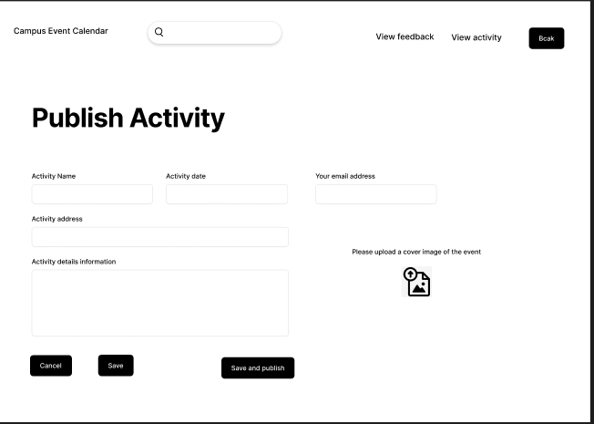
Active publishing interface
Function: Allows faculty to create and post new events.
Design: Input fields containing event name, time, location, description, and save and cancel buttons.

Slide 7
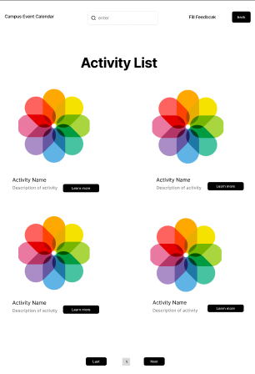
Active list interface
Functions: Displays all current and upcoming events.
Design: contain all the activities, with each event entry linked to detailed information.

Slide 8
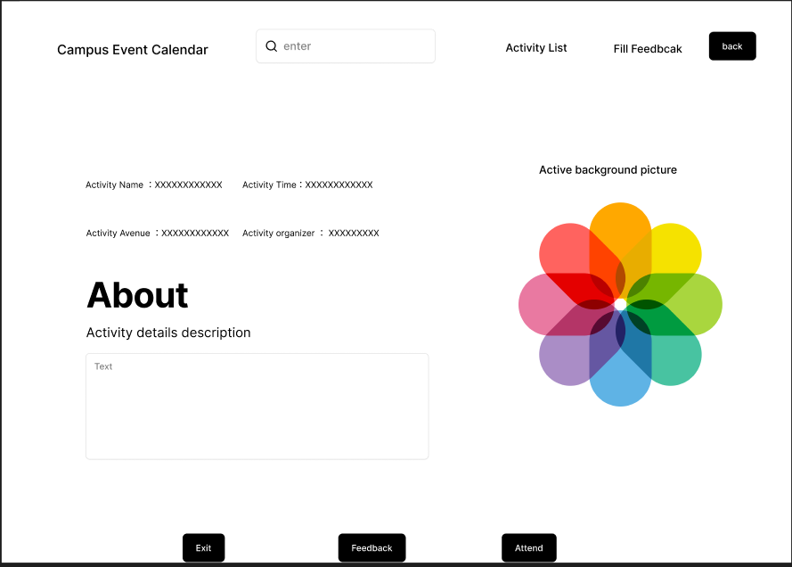
Activity details interface
Function: Displays detailed information about selected activities.
Design: Contains event exit, and feedback, attend button.

Slide 9
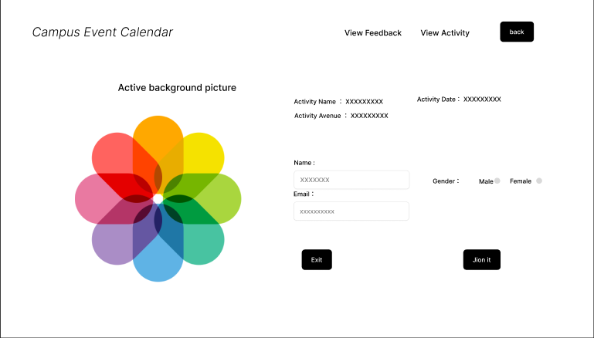
Submit information interface
Function: Allows students to book activities.
Design: Shows what information you need to enter and includes a join buttons .

Slide 10
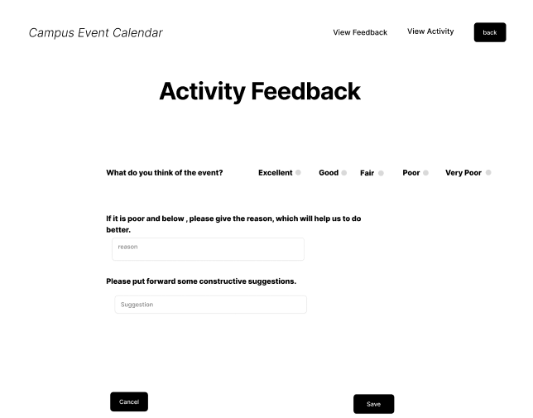
Feedback submission interface
Function: Allows students to submit feedback after the event.
Design: Includes feedback rating, comment input box, submit button.

Slide 11
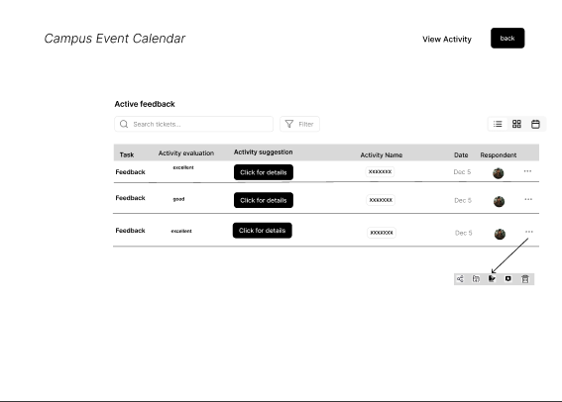
Activity feedback display
Function: Display collected activity feedback information.
Design: Includes feedback ratings, review lists, and statistics.
https://www.figma.com/proto/7VSiHaugFarjcvMrmmXkPa?node-id=1-21&t=nRLbe8EP8QcShHU0-6

Slide 12
The system is designed as a centralized platform to manage and disseminate event information within a campus environment. It serves faculty, students, and staff, enabling them to access, participate in, and provide feedback on various campus events efficiently.
Summary of the proposed system

Slide 13
Thank you！

